Slide 1

Group F-22
Sneha
Sindhu
Tran Pham
Mohamad

Slide 2

SJSU Washington Square
CMPE 272 - Term Project
Agenda
Introduction
Project Features
Design Concept
Issues, challenges and solutions
Demo
Notes:
Tran

Slide 3


Introduction
Notes:
Tran
In the context of this project, we assume that the business have chain stores. Sales data is scattered across retail stores, wholesale stores and online store for Internet customers. Data of retail and wholesale stores is managed by a legacy system, while online store system is just built recently. Therefore we have at least two different data formats.

Slide 4
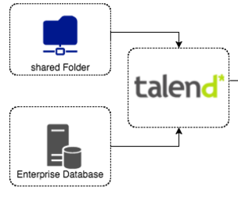

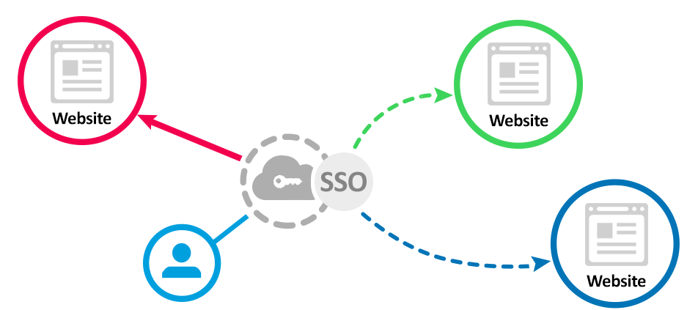
SmartSales - What does it do?
SJSU Washington Square
Centralize data Data Warehouse
Data Visualization
Single Sign On
Notes:
Tran
Project ‘SMART SALES’ leverages the concepts of Data Warehousing and Business Intelligence to achieve insights from those raw data. It visualizes data in a pictorial or graphical format. It enables decision makers to see analytics presented visually, so they can grasp difficult concepts or identify new patterns

Slide 5
Infrastructure Design
SJSU Washington Square
Notes:
Tran

Slide 6
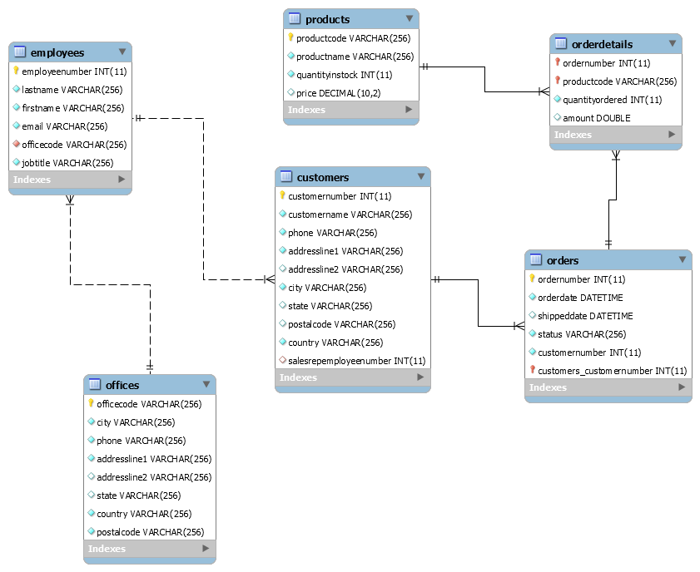
Database Design
Notes:
Mohamad

Slide 7
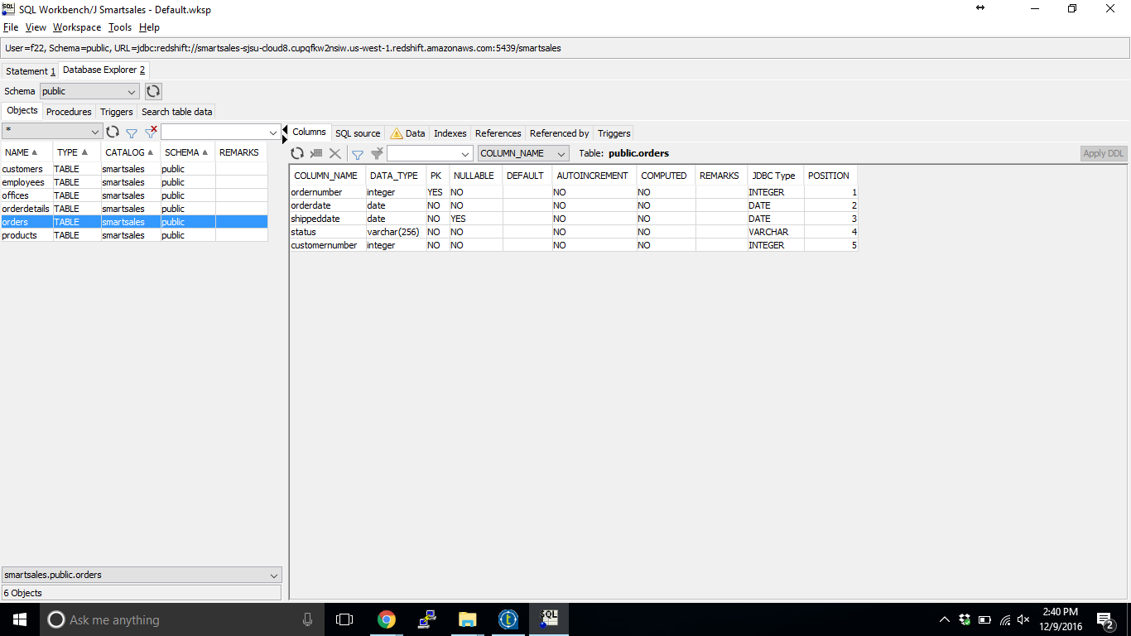
AWS-Redshift
Notes:
Mohamad

Slide 8
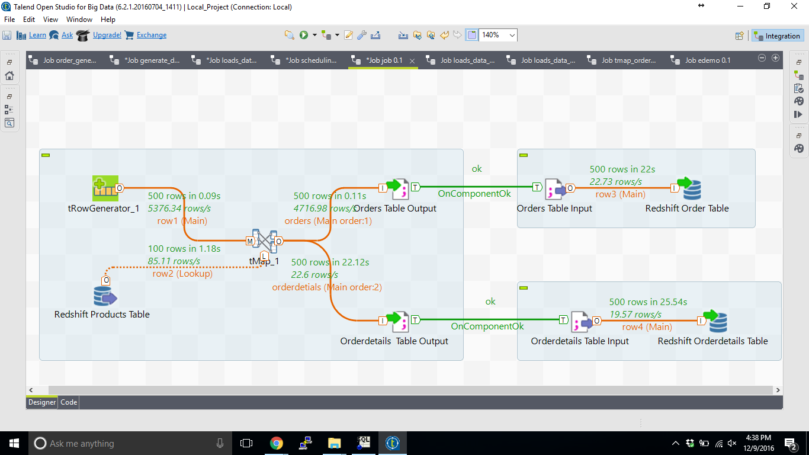
Extract Transform Load with Talend
Notes:
Mohamad

Slide 9
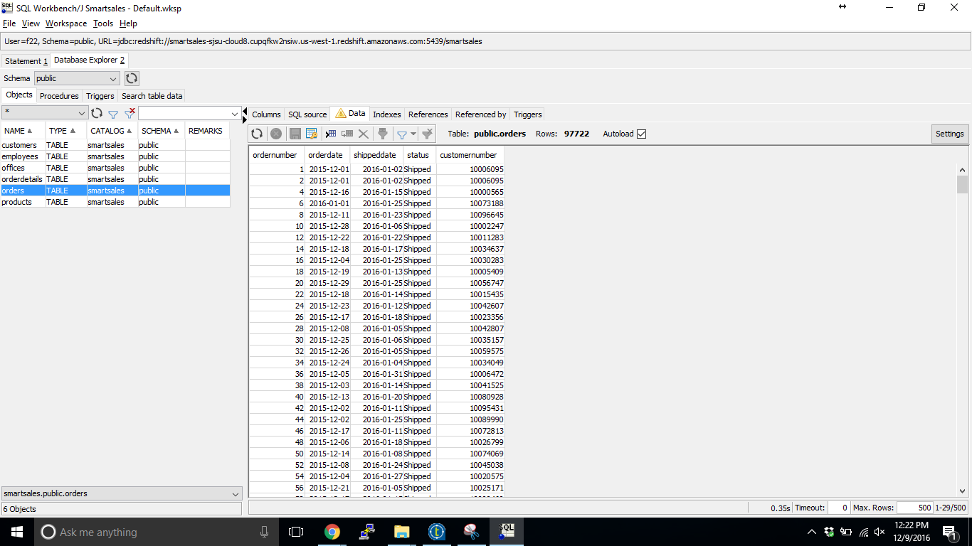
AWS Redshift
Notes:
Mohamad

Slide 10
SJSU Washington Square
Visualize Data with Tableau
Tableau-Data Visualizing and analyzing tool
Turns information/data into visualization.
Why Tableau?
Difficult to analyze huge amount of data directly from table
Helps visually analyze large amount of data..
Develop visually- appealing reports, graphs and dashboards.
Connects easily to nearly any data source- MySQL, Oracle, Amazon Redshift, MS Excel and so on.
Reports are interactive and can be securely shared with other people.
Notes:
Sindhu

Slide 11
SJSU Washington Square
Visualize Data with Tableau(cont’)
Two Products of Tableau
Tableau Desktop
Tableau Online
Tableau Desktop- All work is done in Desktop
Create reports, charts, formatting and putting together as a dashboard
Tableau Online- hosted in cloud
Publish the dashboards from Desktop to Online
Others can also access the dashboards by logging in
Tableau Online serves users across geographic locations, be it in office or on-the-go.
Notes:
Sindhu

Slide 12
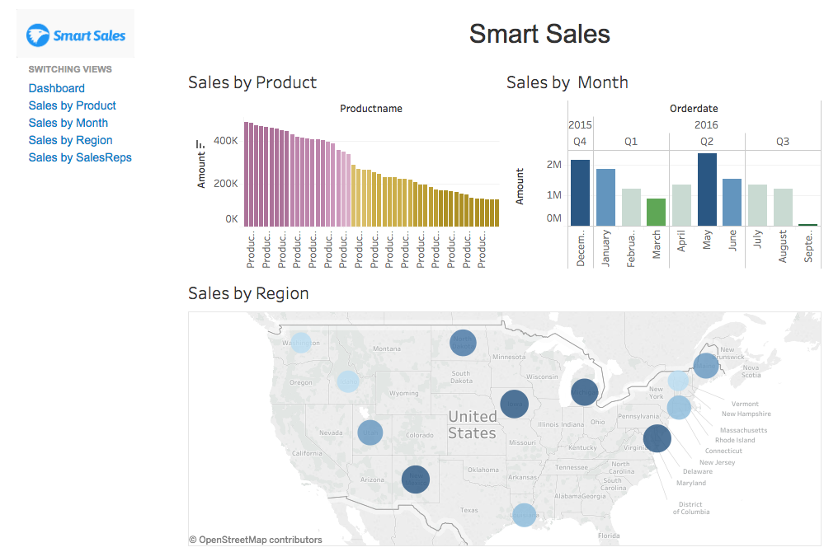
SJSU Washington Square
Notes:
Tran

Slide 13
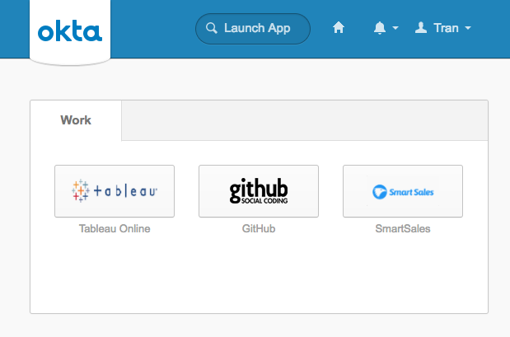
Single Sign On with Okta
SJSU Washington Square
Notes:
Tran
For Single Sign on we have used Okta ,
Okta is a single sign on Tool that integrates Active Directory
We have used to integrate Tableau, github and SmartSales Application

Slide 14
SJSU Washington Square
Jenkins
Installed Jenkins on AWS EC2 Instance
Using Git plugin and S3 Plugin
Integrated Jenkins with Git Repository
Jenkins Job to Deploy Our web Application to Amazon S3
Notes:
Sneha
Jenkins is an open Source Continuous Integration and Continuous Delivery Tool
Our Source code is located in a Github Repository
We host our Static website on Amazon s3, S3 is amazon simple storage service , it is an amazon key value store which can also be used to host static websites
We are using Jenkins as our CI/CD pipeline .
Once we check in the code to Github , Jenkin Deploys it into S3
To achieve this we installed a GitPlugin to communicate with github and S3 plugin to Deploy into Amazon S3
We have deployed Jenkins on An EC2 instance so that it is Internet accessible, this is required for github to communicate with jenkins to inform jenkins when there is code push into the repository

Slide 15
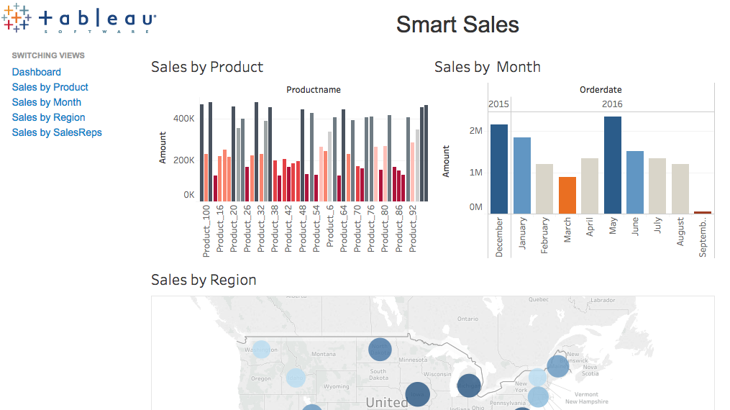
Demo
SJSU Washington Square
Notes:
Sneha , Sindhu and Mohamad
We’ll Show Our Demo in 3 Parts
First the Single Sign On Featuring 3 Applications , Tableau Online, Smart Sals and Github
Demo of Our Smart Sales Application . Showing the changes from our data generating tool
Jenkins Integration ,to make changes to our html page to change the background color

Slide 16


